Slide 1

Wrap Up

Slide 2
Announcements
Ants – Main deadline tonight
Can request extensions if needed, but not beyond 12/8
Remember to add your partner in Gradescope.
Please complete the course feedback survey
Extra Credit if you do. ☺ More EC if 70% fill it out!

Slide 3
Dead Week
Double check the calendar / Ed ☺
https://c88c.org/fa23/weekly-schedule.html
Will hold review sessions (led by TAs + Tutors) during class times
i.e. MW 2-3pm.
My advice:
Finish up the HW/Projects. Then take a break for 1-2 days.
Then study for exams

Slide 4
Final Exam Information
Time: Thurs 3-6pm
We'll be split in 3 rooms; emails to be sent next week
Confirmations on accommodations, alt times sent soon.
Similar to Midterm!
Fall 2022 will be released as practice on Gradescope, but is very different. (Not sure if we have a solutions doc tho)
Clobber Policy:
If you improve upon your midterm score, your midterm score goes up
Everything in class is in scope, but focus on post-midterm topics.

Slide 5
Is Your Brain Full Yet?
Data: values, literals, operations,
Functions
Variables
List, Tuples, Dictionaries
Function Definition Statement
Conditional Statement
Iteration: list comp, for, while
Lambda function expr.
Higher Order Functions
Higher order function patterns
Map, Filter, Reduce
Recursion
Abstract Data Types
Mutation
Class & Inheritance
Exceptions
Iterators & Generators
SQL / Declarative Programming

Slide 6
Grading Updates
http://howamidoing.c88c.org/
We will periodically update over the next weeks.
Sum everything up!
Lecture Self-Checks
Basically everyone should 20/20 on the lecture self-checks. That's the point. ☺
Correctness does count! Resubmit them, if you haven't gotten them right. (No late penalty!) Lateness does not matter
There are 26 self-checks which means you could have skipped 6 lectures
There's a few "bonus" ones on Gradescope, just from different semesters that are optional practice, but can get you to 20 pts if you need.

Slide 7
Thank You's!!

Slide 8
CS88 Staff
Head TAs:
Hridhay Suresh
Jessica Lin
TAs:
Ethan Yoo
Karim Kaylani
Michelle Chen
John Teng
Ramya Chitturi
Rebecca Dang
Tutors:
Sean Yang
Angela Bi
Ananyaa Jain
Christy Quang
Liliana Gonzalez
Miha Bhaskaran
Morgan Dehdashti

Slide 9
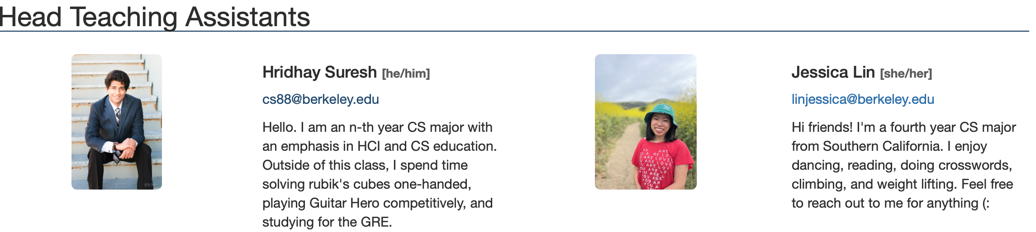
CS88 Head TAs

Slide 10
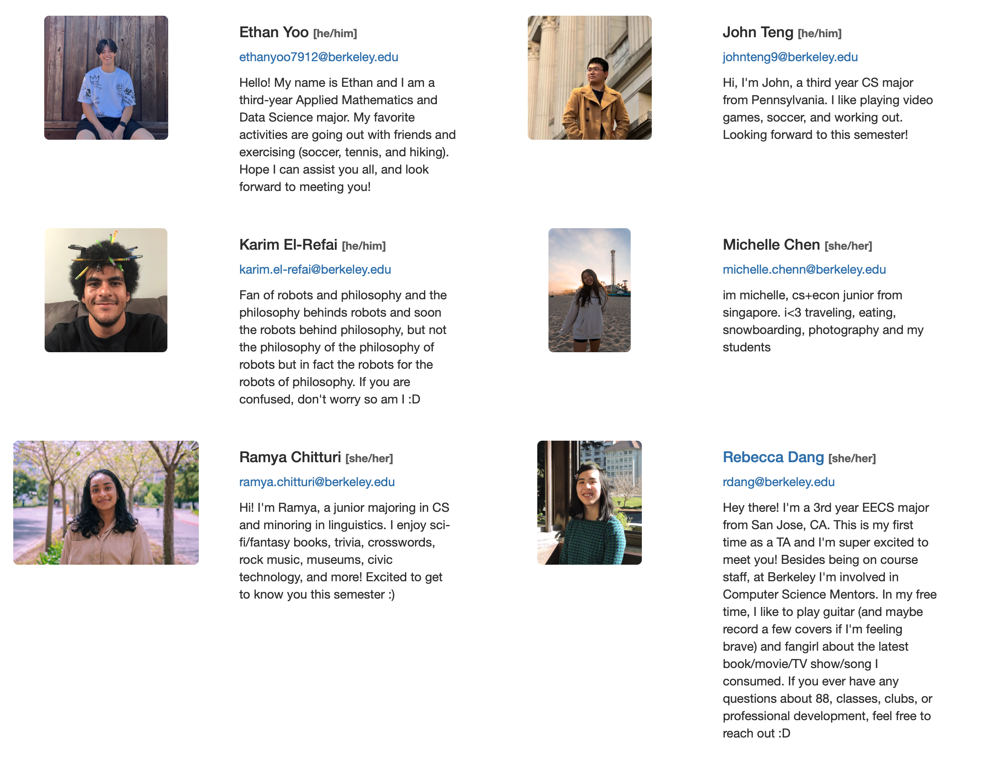
CS88 TAs

Slide 11
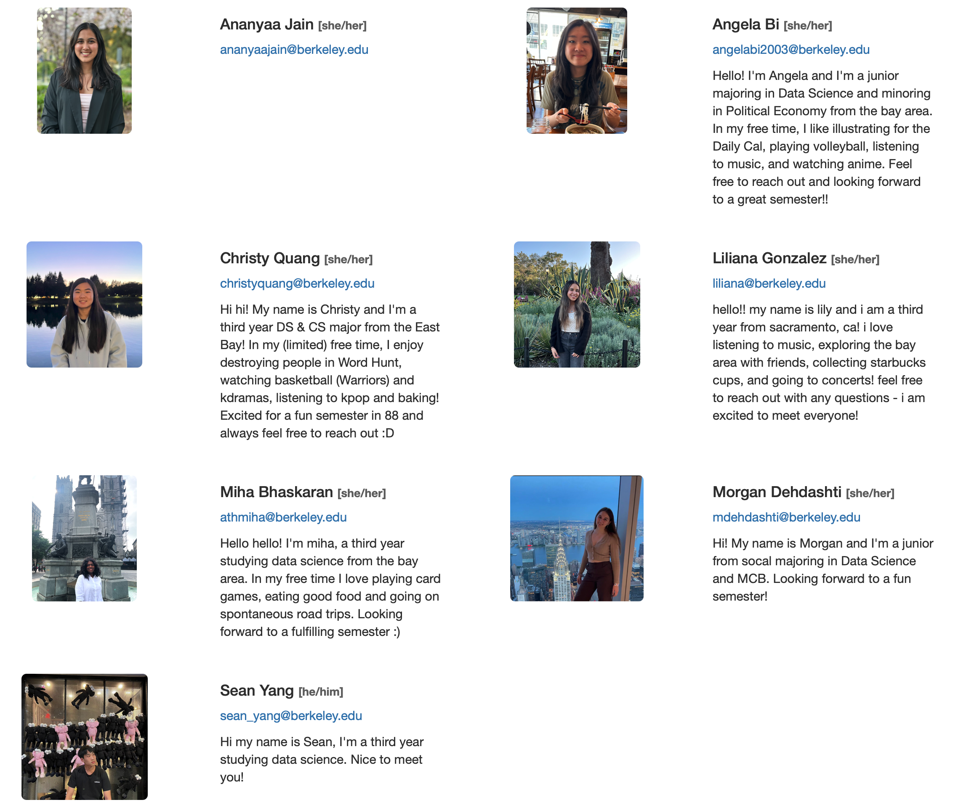
CS88 Tutors

Slide 12
Wrap Up

Slide 13
CONGRATULATIONS!!

Slide 14
THANK YOU!

Slide 15
COME JOIN COURSE STAFF!

Slide 16
The One Big Thing…

Slide 17

Abstraction
Detail removal
“The act of leaving out of consideration one or more properties of a complex object so as to attend to others.”
Generalization
“The process of formulating general concepts by abstracting common properties of instances”
Technical terms: Compression, Quantization, Clustering, Unsupervised Learning
Henri Matisse “Naked Blue IV”

Slide 18
Keep on Programming

Slide 19
LOTS of Courses to Follow Up! [Courses]
Explore all the DS connectors
Data 88E (Econ)
Stat 88 / DATA C88S
Data 100: Principles of DS
Data 101: Data Engineering
Data 102: Data, Inference, and Decisions
Data 104: Human Context and Ethics
Data 140: Probability
INFO – Course Schedule Varies!
INFO C103 in Spring: "History of Information"
Some Database courses, web development, etc.

Slide 20
CS Courses
CS61B: (conventional) data structures, statically typed production languages.
CS61C: computing architecture and hardware as programmers see it.
CS70: Discrete Math and Probability Theory.
CS170, CS171, CS172, CS174: “Theory”—analysis and construction of algorithms, cryptography, computability, complexity, combinatorics, use of probabilistic algorithms and analysis.
CS161: Security
CS162: Operating systems.
CS164: Implementation of programming languages
CS168: Introduction to the Internet
CS160, CS169: User interfaces, software engineering
CS176: Computational Biology

Slide 21
CS Courses Part 2
* CS182, CS188, CS189: Neural networks, Artificial intelligence, Machine Learning
CS184: Graphics
CS186: Databases
CS191: Quantum Computing
CS195: Social Implications of Computing
EECS 16A, 16B: Designing Information Systems and Devices
EECS 126: Probability and Random Processes
EECS149: Embedded Systems
EECS 151: Digital Design
CS194: Special topics. (e.g.) computational photography and image manipulation, cryptography, cyberwar.
Plus graduate courses on these subjects and more.

Slide 22
EE Courses Are There Too
EE105: Microelectronic Devices and Circuits.
EE106: Robotics
EE118, EE134: Optical Engineering, Photovotalaic Devices.
EE120: Signals and Systems.
EE123: Digital Signal Processing.
EE126: Probability and Random Processes.
EE130: Integrated Circuit Devices.
EE137A: Power Circuits.
EE140: Linear Integrated Circuits (analog circuits, amplifiers).
EE142: Integrated Circuits for Communication.
EE143: Microfabrication Technology.
EE147: Micromechanical Systems (MEMS).
EE192: Mechatronic Design.

Slide 23
Personal Course Recommendations
INFO C103
Computational Photography – especially if you like photoshop
HCE Courses
History, Poli Sci, Psychology
LS110 Brilliance of Berkeley (Spring)
https://curricularconnections.berkeley.edu/ls110/
An 'experiment' of sorts, but seems cool

Slide 24
What's next? (Otherwise)
Programming contests
Hackathons
More paradigms and languages: the web
The open-source world: Go out and build something!
Above all: Have fun!

Slide 25
And there's lots more to Python!

Slide 26
What can you do with Python?
Almost anything!
Webapp backends
Web scraping
Natural Language Processing
Data analysis
Machine Learning
Scientific computing
Games

Slide 27
What can you do with Python?
Almost anything! Thanks to libraries!
Don't try to memorize libraries, learn how to learn how to use them!
Webapp backends (Flask, Django)
Web scraping (BeautifulSoup)
Natural Language Processing (NLTK)
Data analysis (Numpy, Pandas, Matplotlib)
Machine Learning (FastAi, PyTorch, Keras)
Scientific computing (SciPy)
Games (Pygame)

Slide 28
(Reminder) Peer Resources: Join Ed!
https://eecs.link/data001 - Data 001 Ed Group
https://eecs.link/eecs101 - EECS 101 Ed Group

Slide 29
Ask Us Anything!

Slide 30
THANK YOU!
(Again!)

